Slide 1
Family and friends Grade 3
Unit 8: It’s hot today!
Lesson 4: Phonics

Slide 3
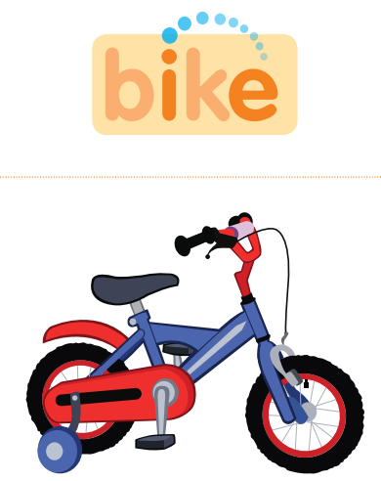
bike (n)
xe đạp

Slide 4
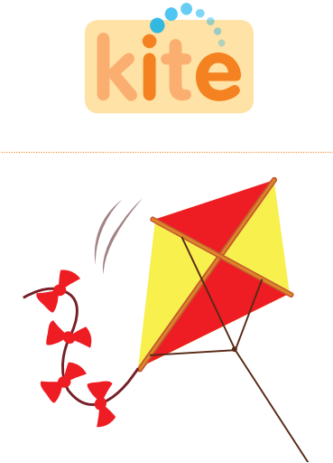
kite (n)
con diều

Slide 5
white (adj/ n)
trắng/ màu trắng

Slide 6
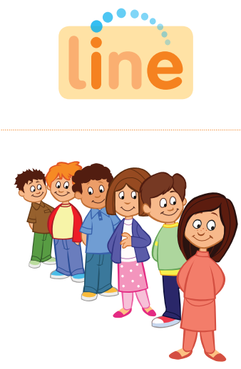
line (n)
hàng

Slide 7
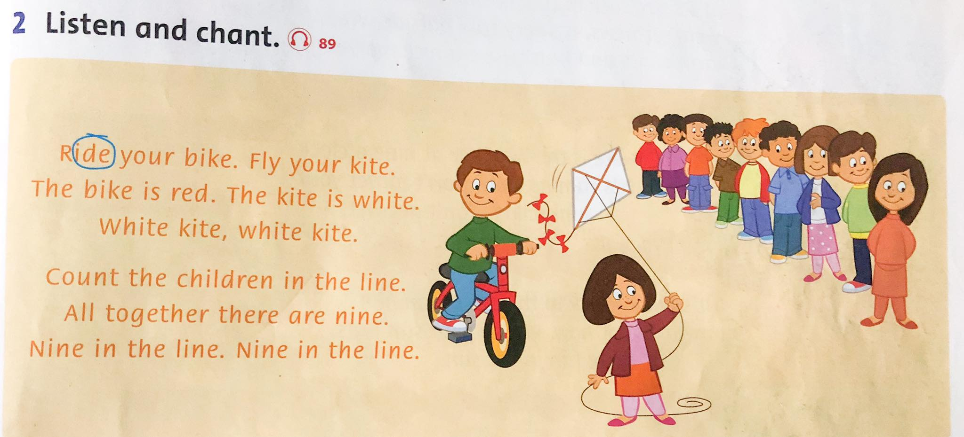

Slide 8
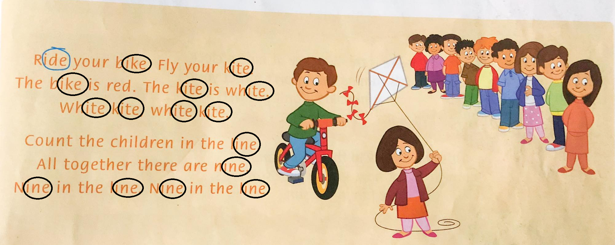
3. Read the chant again. Circle the sound i_e.

Slide 9
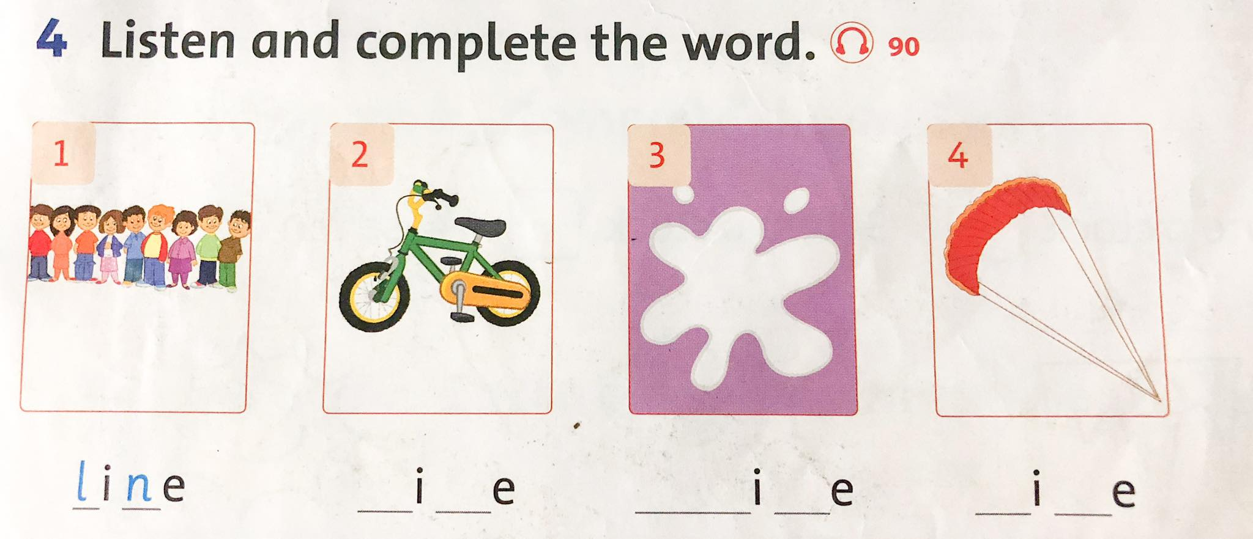

Slide 10
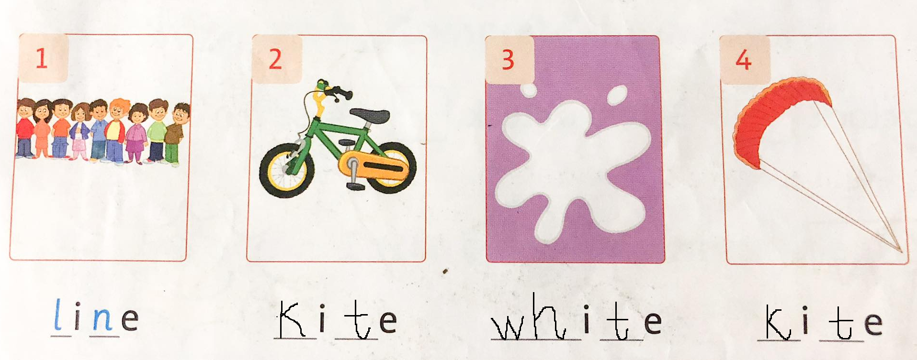
Now check your answer.

Slide 11
Exercise: Order the letters

